Slide 1

Welcome
Lab 3- Tips for designing a dominant website

Slide 2
Lab 3
Expectations
Chat Support Available During Webinars
Knowing Your Resources
Webinar Process
Facebook Support
Search: Crexendo UP Website Competition
Online Resources
up.Crexendo.com/unr

Slide 3
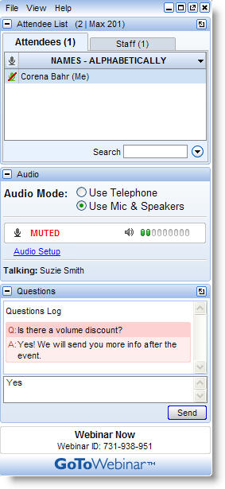
Lab 3
Live presentation
Attendees are muted
Type your questions in the “Questions” window
Questions answered live or via chat reply

Slide 4
Lab 3
Webinar 2 Review
Builder Navigation
CRO Headers
Page Building
Elements
Finding a dropshipper (pgs 14-15 roadmap)
  Integrated Dropshippers
  Tools for assistance
Payment Processors & Linking to Builder
  Preferred Providers (page 40 of roadmap)
Shipping Options
Introduction to Ordering Rules
Q&A

Slide 5
Lab 3
Webinar 2 Review
Builder Navigation
CRO Headers
Page Building
Elements
Understanding the Builder
  Tabs
  Designs(Layouts)
    Selection
    Columns
  Schemes
    Customizing
Q&A

Slide 6

Lab 3 CRO Header
Webinar 2 Review
Builder Navigation
CRO Headers
Page Building
Elements
Q&A

Slide 7
Lab 3
  Pages
    Home Page
    Products Page
    About Us Page
    Contact Us Page
    Privacy Policy Page
Webinar 2 Review
Builder Navigation
CRO Headers
Page Building
Elements
Q&A

Slide 8
Lab 3
Webinar 2 Review
Builder Navigation
CRO Headers
Page Building
Elements
  Introduction to Elements
  Layers
  Types of Elements
  Adding Elements from Preview
Q&A

Slide 9
Lab 3
  Most used elements
    Text Element
    Image Element
    Category Products
    Page List
    Product
Webinar 2 Review
Builder Navigation
CRO Headers
Page Building
Elements
Q&A

Slide 10
Lab 3
Webinar 2 Review
Builder Navigation
CRO Headers
Page Building
Elements
Q&A

